Slide 1
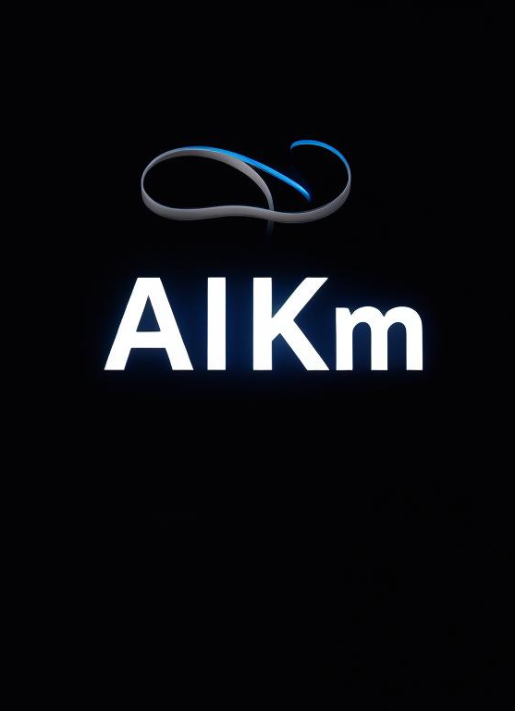

Demos
Chatbots
GPT to retrieve information from dataset
Generate questions from dataset
Notes:
https://getimg.ai/image-editor

Slide 2
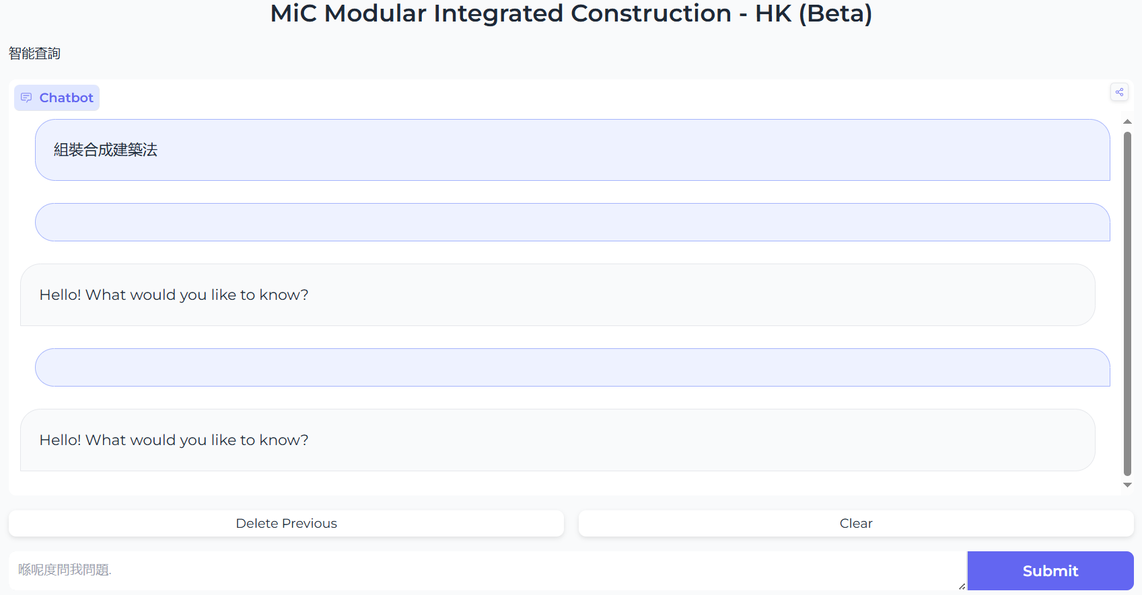
Content Retrieval with Natural Language from Dataset
https://huggingface.co/spaces/hoson/MiC

Slide 3
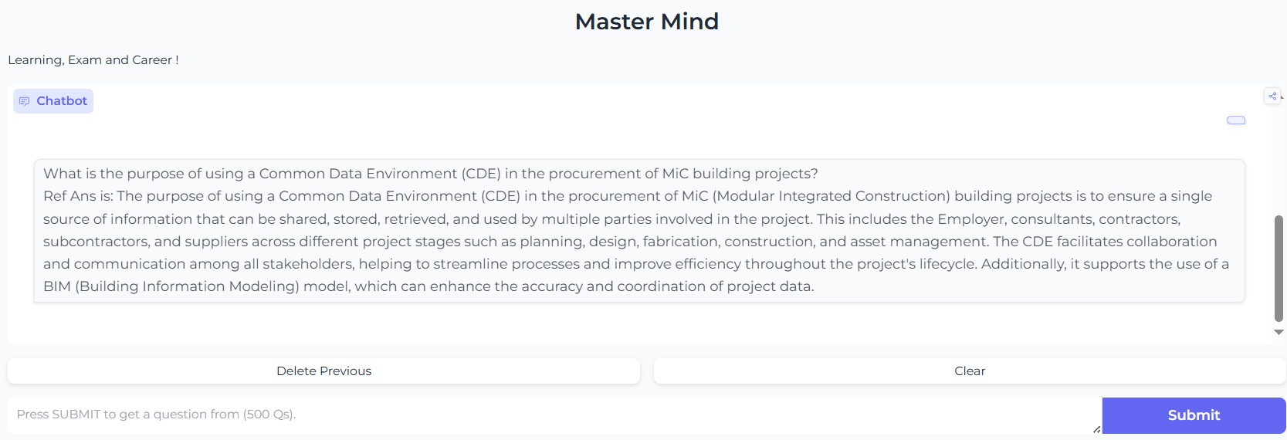
Reverse – Question Generation from Dataset
https://huggingface.co/spaces/hoson/qGen

Slide 4
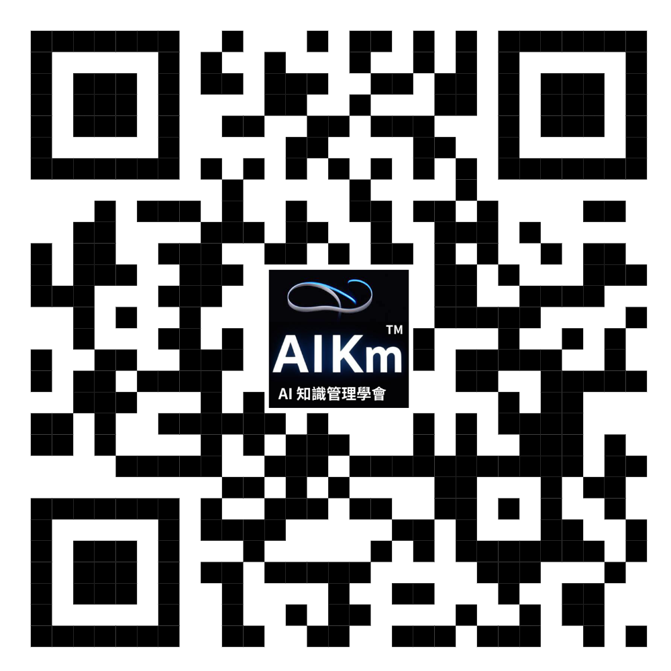
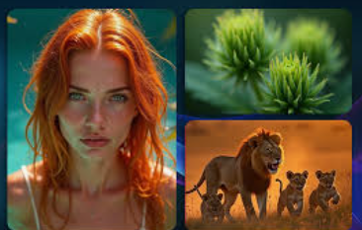
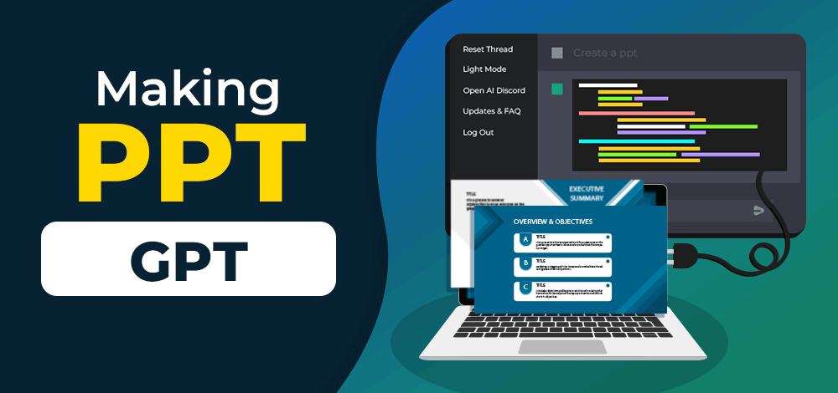
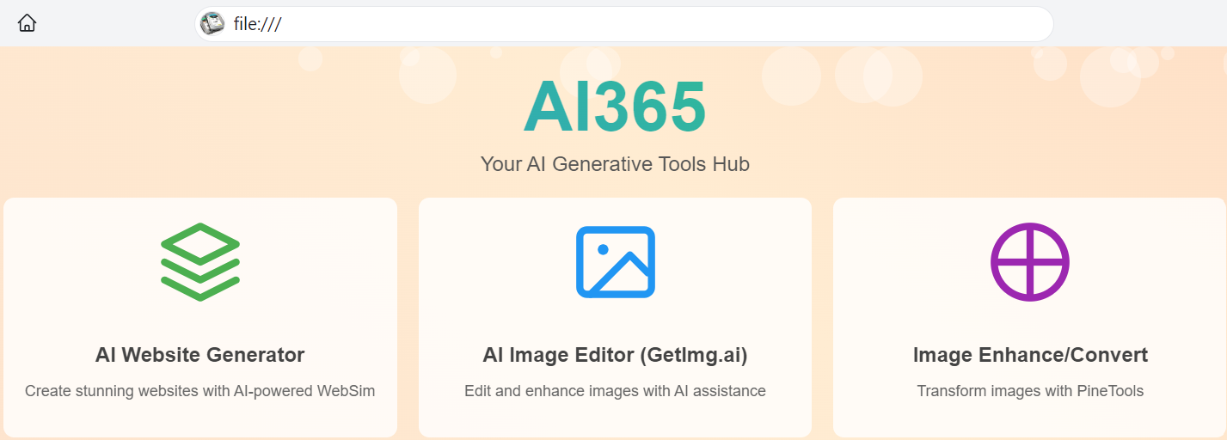
Next Lecture – Coming Soon (8 Nov)
AI Generation for Website and PPT
  Text to Text, Text to Website, Text to Images/PPT
Notes:
https://websim.ai/c/7g3kIIPcYPzeVE0hh

Slide 5
Coming Next Event:
AI 知識管理學會
Aug 2024 V3.2

Slide 6
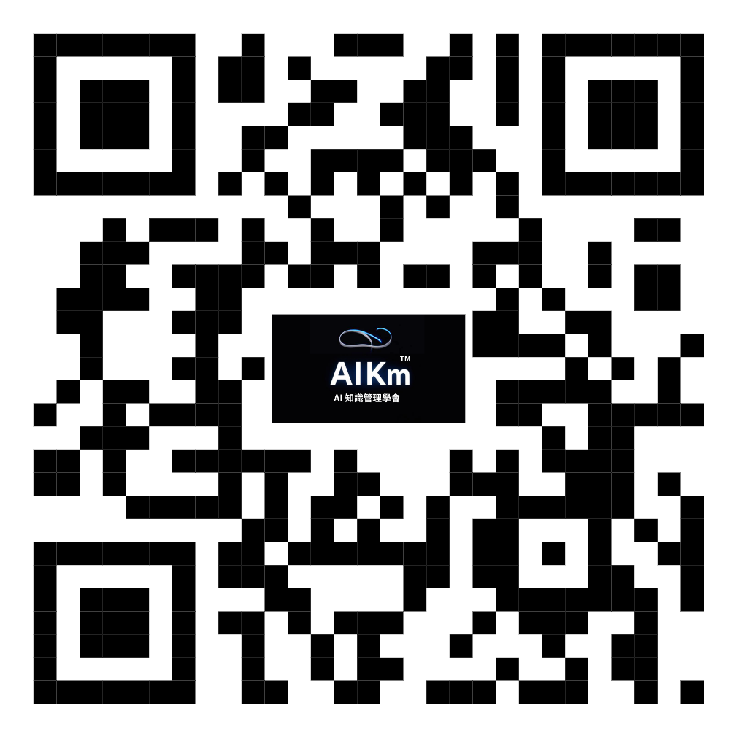
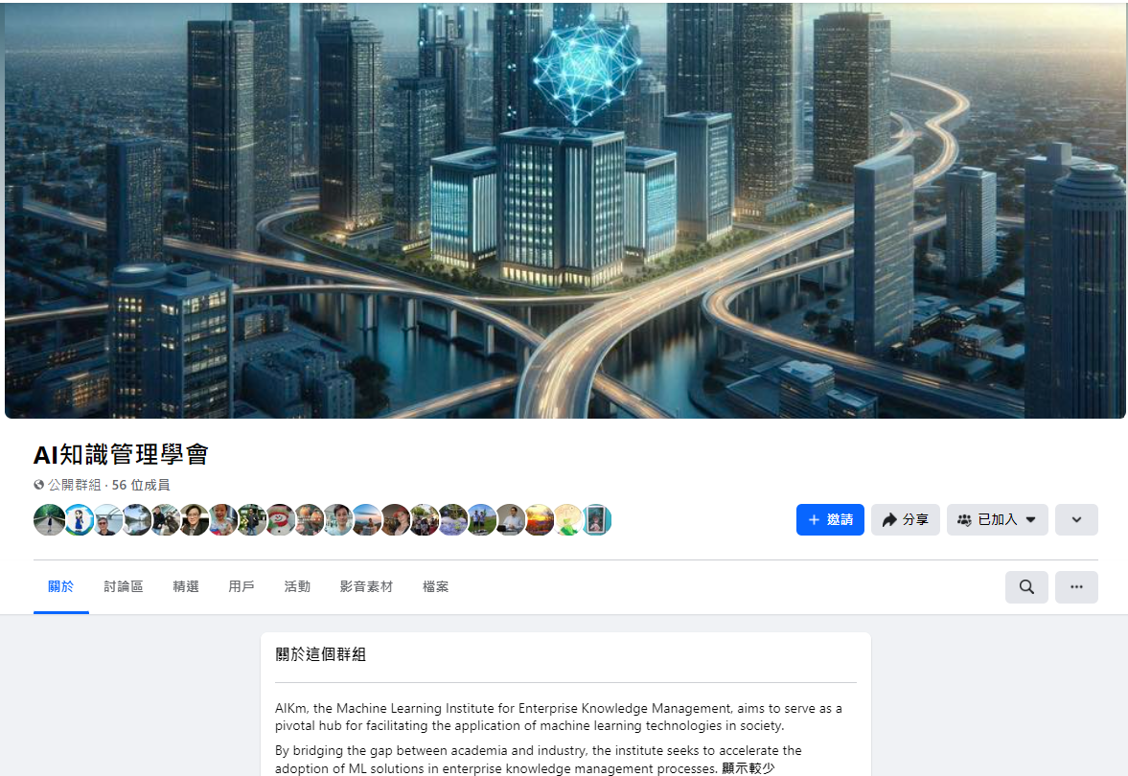
Join
AI 知識管理學會
Aug 2024 V3.2

